Slide 1

5g Network
Presented by :Maskur Al Shal Sabil
ID: IT18021
Dept : Information & Communication Technology
Mawlana Bhashani Science & Technology University

Slide 2
Learning Outcome
Evolution of network from 1G to 5G
Architecture of 5g Network
Deployment model
Application of 5g Network

Slide 3
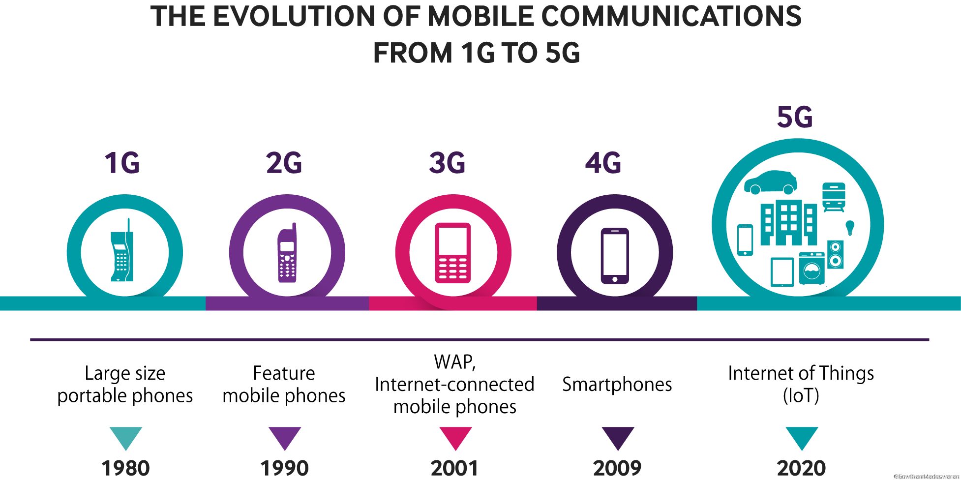

Slide 4
LTE/ Wimax
2010’s
All Ip , Packet switching
2000s
HSPA+ , MIMO , Pocket Switching for data
Text , multimedia message, Digital phone
1990s
1970/1980
The brick, Analog phone \
5G
4G
3G
2G
1G

Slide 5
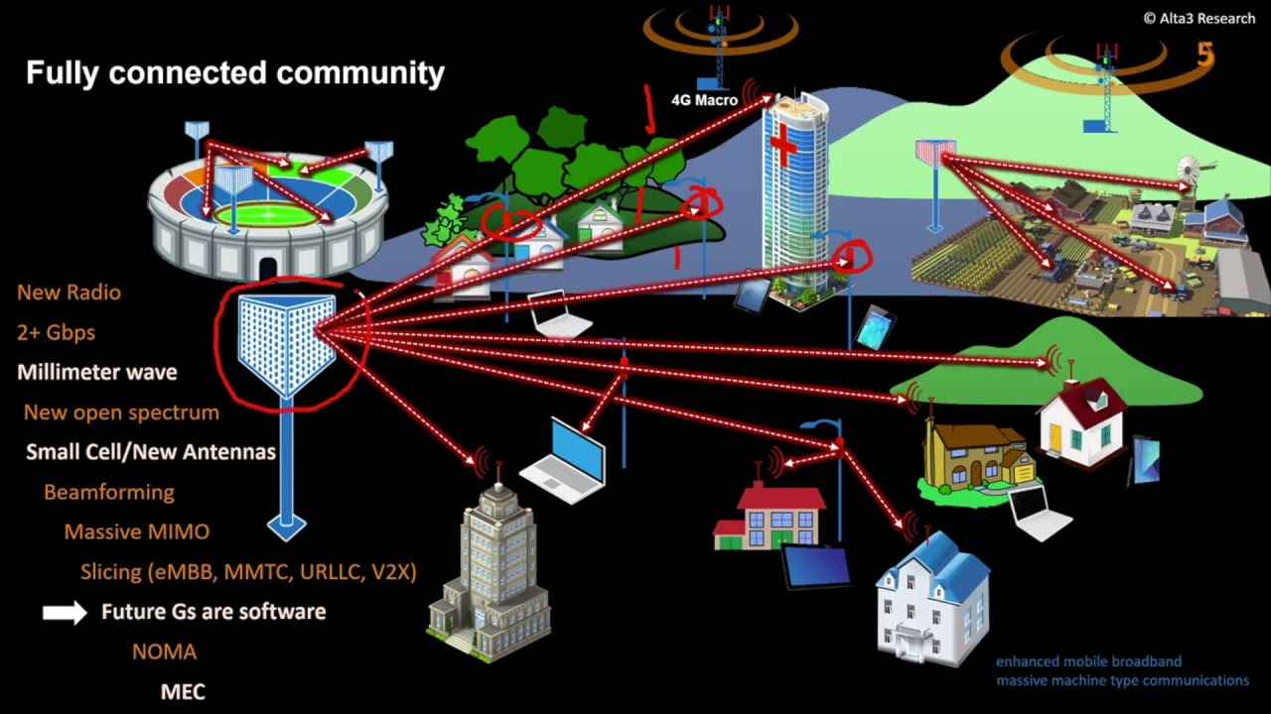
Fully connected

Slide 6
What makes 5G so exciting
Milimeter wave
MEC
Massive MIMO
NOMA
Small Cell
Beamforming

Slide 7
Millimeter Wave
Gps,wifi,wimax,4G,3G,3band satellite
Millimeter wave
1 6 10 30 100 300 Ghz
Radio Specturm

Slide 8
Advantages of Millimeter wave
It is new and less used band
Higher frequency wave carries much more data than lower frequency wave.
Millimeter wave makes it possible to have massive antena.

Slide 9
Massive MIMO
The relationship between the wave frequency and antenna size is inversely proportional.

Slide 10
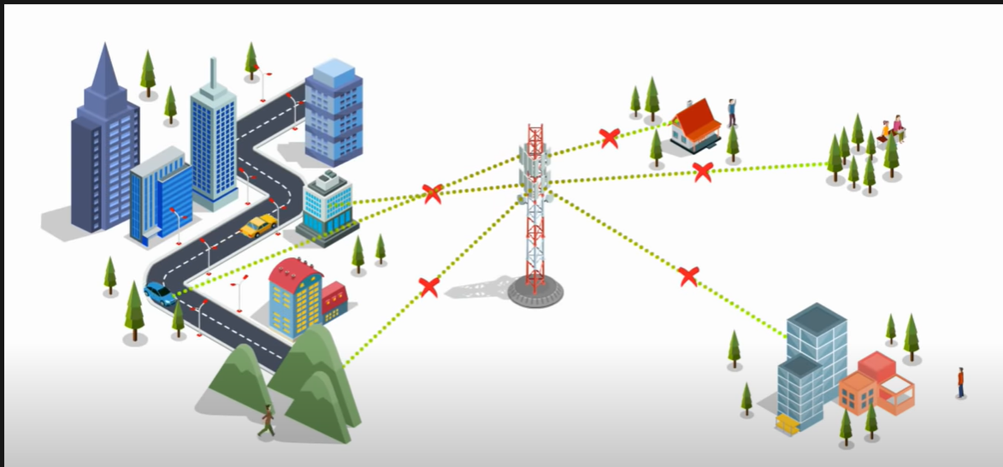
Collision of wave

Slide 11
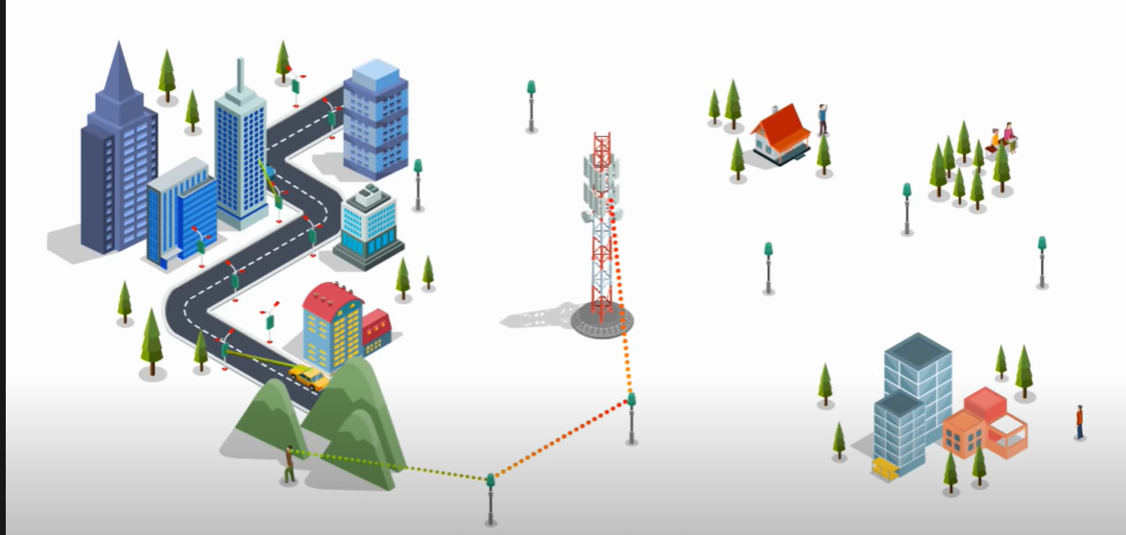
Small cell

Slide 12
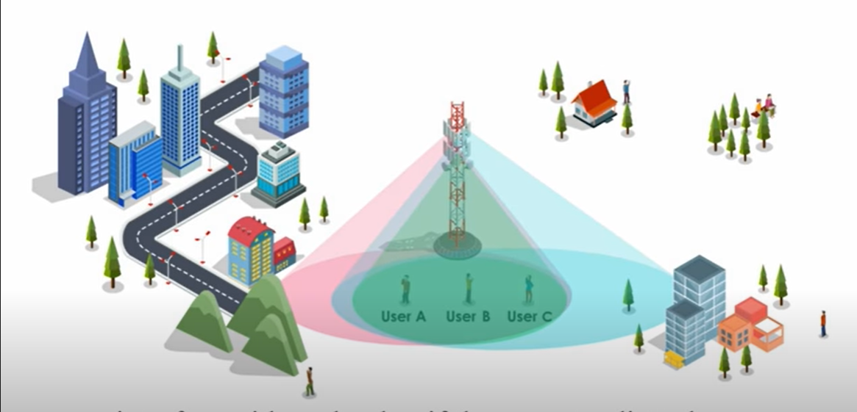
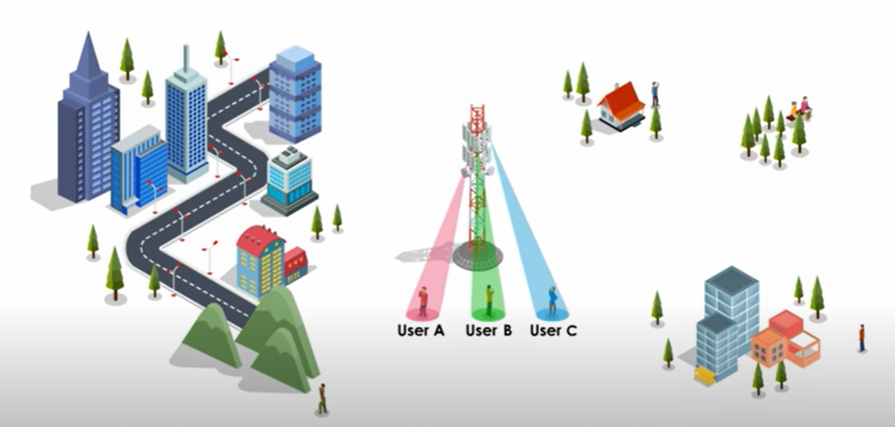
Standard network and beamforming

Slide 13
NOMA
Power
frequency
Orthogonal Multiple Access Non-Orthogonal Multiple Access

Slide 14
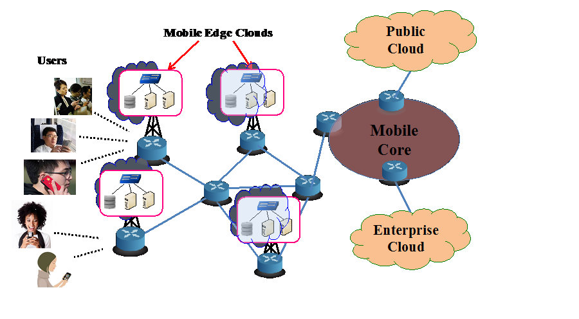
Mobile Edge Computing(MEC)

Slide 15
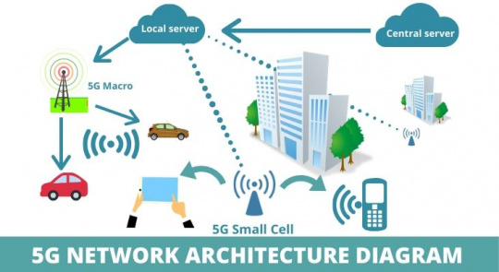
How does it work

Slide 16
How does it work
The Radio Access Network - Consists with small cells, towers, masts and dedicated in-building and home systems that connect mobile users and wireless devices to the main core network. Where 5g have MIMIO
The Core Network : Handle mobile exchange and data network that manages all of the mobile voice, data and internet connections. For 5G, the ‘core network’ is being redesigned to better integrate with the internet and cloud based services and also includes distributed servers across the network improving response times (reducing latency).
Network Slicing : Enables a smart way to segment the network for a particular industry, business or application. For example emergency services could operate on a network slice independently from other users.
Network Function Virtualization (NVF) - is the ability to instantiate network functions in real time at any desired location within the operator’s cloud platform. Network functions that used to run on dedicated hardware for example a firewall and encryption at business premises can now operate on software on a virtual machine. NVF is crucial to enable the speed efficiency and agility to support new business applications and is an important technology for a 5G ready core

Slide 17
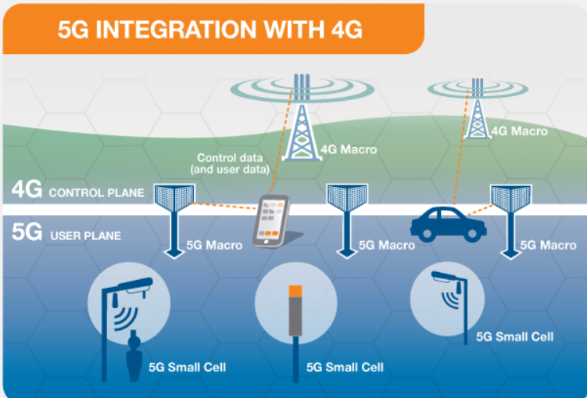
Working with 4G network

Slide 18
Why 5G
5G technology offers an extremely low latency rate, the delay between the sending and receiving of information. From 200 milliseconds for 4G, we go down to 1 millisecond(1ms) with 5G.
A millisecond is 1/1000 of a second.
Fixed wireless access (from 2018-2019 onwards)
Enhanced mobile broadband with 4G fall-back (from 2019-2020-2021)
Massive M2M / IoT (from 2021-2022)
Ultra low-latency IoT critical communications (from 2024-2025)
Some critical applications like self-driving cars require very aggressive latency (fast response time) while they do not require fast data rates.
Conversely, enterprise cloud base services with massive data analysis will require speed improvements more than latency improvements.

Slide 19
Reference
Fundamentals of 5G Mobile Networks, Jonathan Rodriguez
^{Wikipedia}
http://www.emfexplained.info/?ID=25916#How%20does%205G%20work
https://www.qualcomm.com/invention/5g

